Slide 1
Project feasibility
12/1/23
L.E.O.S
<number>/10

Slide 2
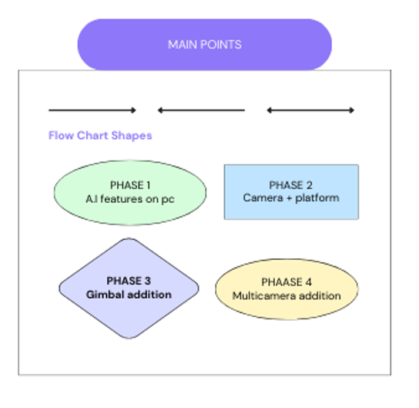
12/1/23
L.E.O.S
<number>/10

Slide 3
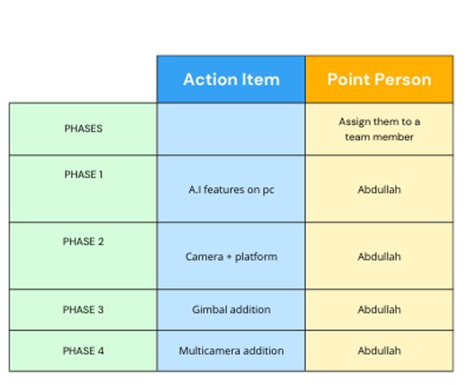
Project phases
12/1/23
L.E.O.S
<number>/10

Slide 4
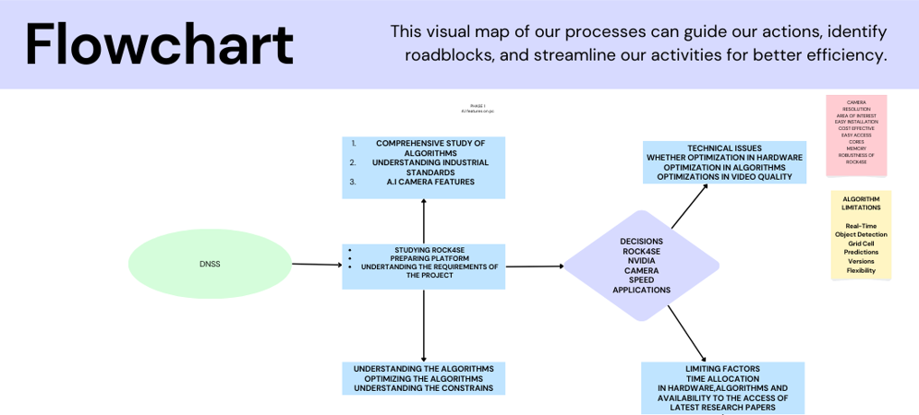
12/1/23
L.E.O.S
<number>/10

Slide 5
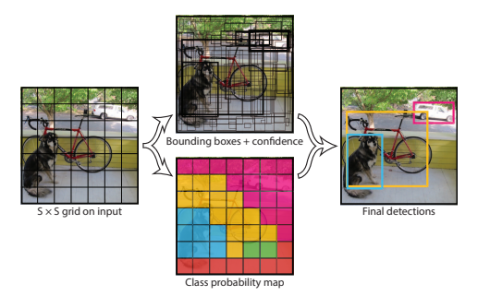
Phase 1
A.I features on pc
Comprehensive study of ALGORITHMS
YOLO V8 comprehensive study phase
12/1/23
L.E.O.S
<number>/10

Slide 6
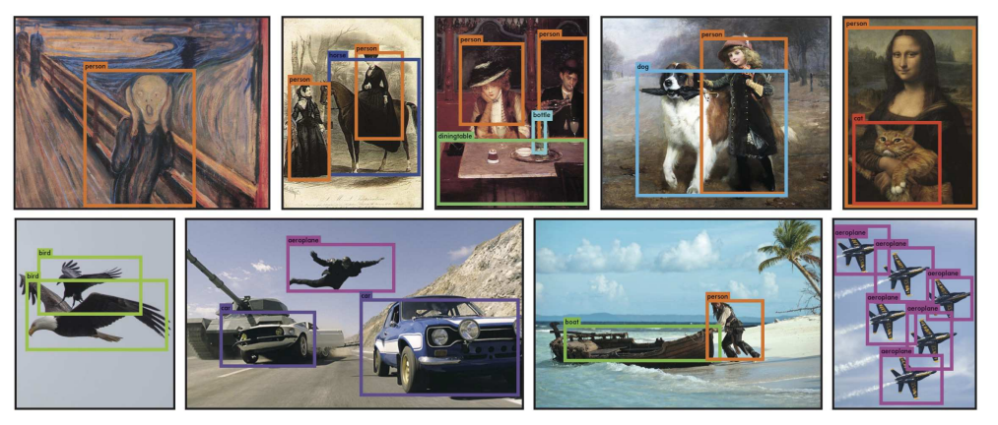
AIMS
12/1/23
L.E.O.S
<number>/10

Slide 7
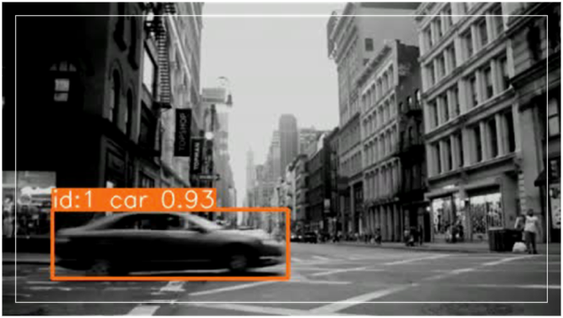
TRACKING is implemented
Video for view
12/1/23
L.E.O.S
<number>/10

Slide 8
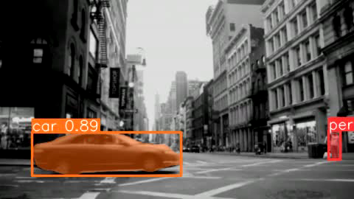
segmentation is implemented
12/1/23
L.E.O.S
<number>/10

Slide 9
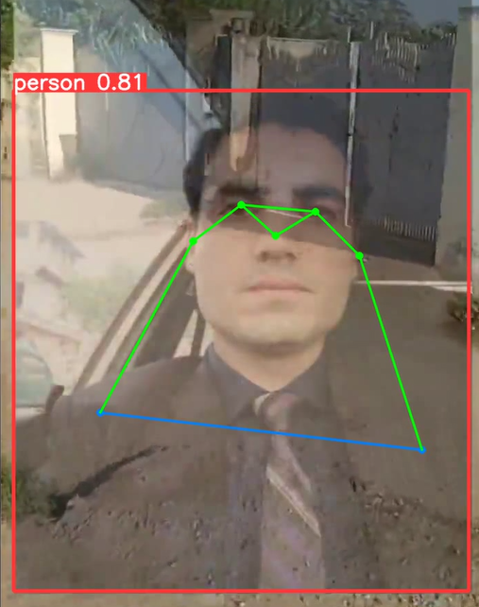
POSING IMPLEMENTED
12/1/23
L.E.O.S
<number>/10

Slide 10
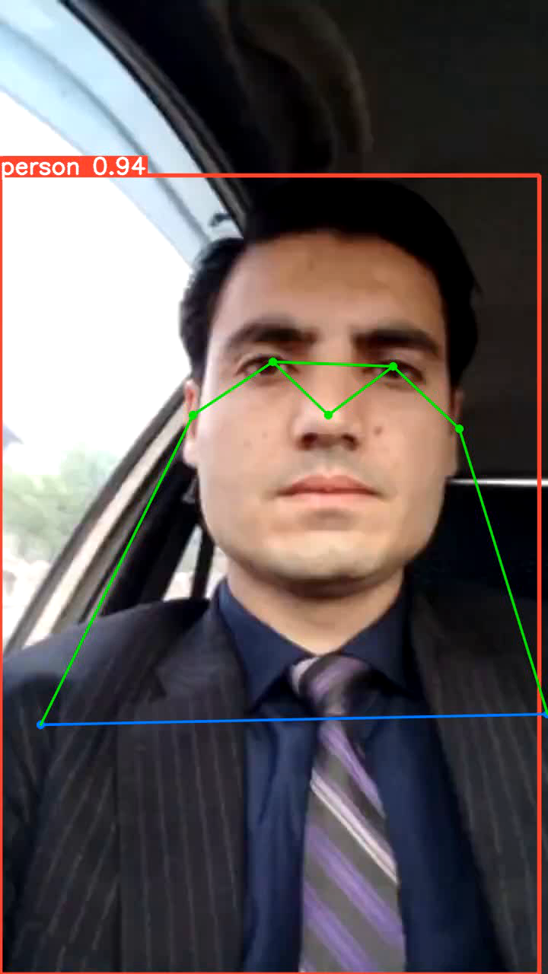
POSING IMPLEMENTED video
12/1/23
L.E.O.S
<number>/10

